Slide 1


Phishing & Social Engineering: Protecting
Yourself Online
Learn to recognize, prevent, and respond to phishing and social engineering attacks effectively. Protect your personal and work data from cyber threats.
by Jagan mohan Reddy

Slide 2
What is Phishing and How Does it Work? (Examples)
Phishing Basics
Phishing tricks users into revealing sensitive info through fake emails or sites.
Attackers often impersonate trusted sources like banks or colleagues.
Example Scenarios
Fake bank alerts prompting login
Impersonated CEO requesting urgent fund transfers
Links to malicious websites disguised as legitimate

Slide 3
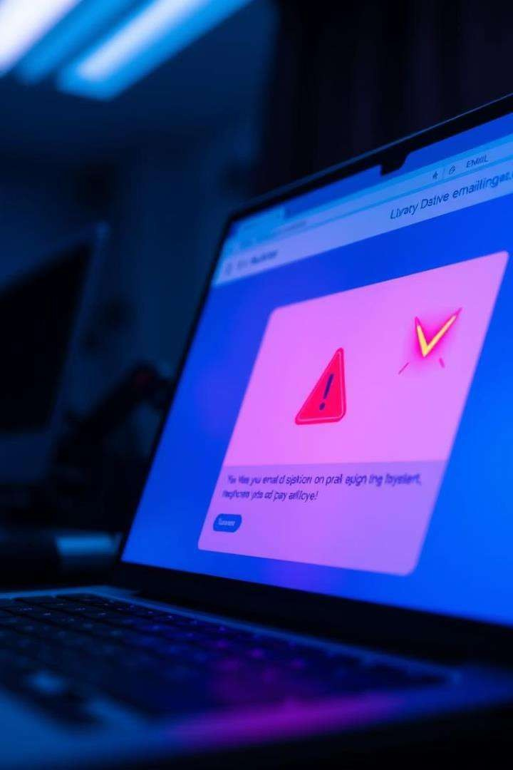
Spotting the Red Flags: Identifying Phishing Emails
Check the Sender
Look for unusual or misspelled email addresses.
Be Wary of Urgency
Phishing often pressures you to act immediately.
Look for Poor Grammar
Errors and awkward phrasing are common in phishing messages.
Avoid Unknown Links
Hover to preview URLs before clicking.

Slide 4

Common Social Engineering Tactics to be Aware Of
Pretexting
Creating a fabricated scenario to gain confidential info.
Baiting
Offering something enticing to lure victims into a trap.
Quizzes & Surveys
Using fake surveys to collect personal data.
Tailgating
Gaining physical access by following authorized personnel.

Slide 5
Protecting Your Personal Information Online
Strong Passwords
Two-Factor Authentication
Limit Sharing
Update Software
Use long, unique passwords with a mix of characters.
Avoid oversharing personal info on social media.
Keep systems and apps up to date to fix security flaws.
Add an extra verification step to your accounts.

Slide 6

Best Practices for Secure Email Communication
1
Verify Recipients
Double-check email addresses before sending sensitive info.
2
Use Encryption
Encrypt emails containing confidential or personal data.
3
Beware Attachments
Only open attachments from known, trusted sources.
4
Report Suspicious Emails
Notify your IT team or security department immediately.

Slide 7
Real-World Case Studies: Learning from Others' Mistakes
CEO Fraud Case
Credential Theft
Malware Infection
Employee transferred $500K after impersonated CEO email.
Phishing email stole login credentials, causing data leak.
Fake update email installed ransomware on company systems.

Slide 8

Staying Vigilant:
Resources and Continuous Learning
Ongoing Training
Regularly update your knowledge with security courses.
Use Trusted Sources
Follow cybersecurity blogs and official advisories.
Practice Awareness
Maintain a cautious mindset with all digital communications.

